Slide 1
Capstone Project 4 Netflix Movies & Tv show Clustering Data science learners Team Team Members: Ayush Goyal
M Sameer Ahamed
Nitesh Bhowmick

Slide 2
Content
Problem statement
Data summary
Exploratory Data prediction
EDA For Netflix Movie & TV show Clustering
Machine Learning
Feature Engineering
K-Means clustering
Dendrogram
Agglomerative Clustering.
Challenges
Conclusion

Slide 3
Problem Statement
Prediction based on Country
Prediction based on Rating
Prediction based on production growth
Prediction based on top 10 genre movies & TV show
Prediction based on Actor with most content on platform
Prediction based on Top 15 countries with most contents
Prediction based on Highest No in One season

Slide 4
Data Summary
In the Netflix movies &Tv shows project there is a dataset which contains Netflix Tv shows & movies information.
There are two dataset that is Rossmann Store dataset and Store dataset.
Netflix has 7787 rows and 12 columns
Data contain information on rating, duration, Genre, country, director, Title, release year.

Slide 5
Exploratory Data Prediction
Exploratory Data Prediction is also known as EDA, is the process of interpreting datasets by summarizing their key properties and frequently them
EDA refers to the critical process of performing initial investigation on datasets so as discover the patterns, to spots anomalies , to hypothesis, and to check assumptions with the help of summary statistics and graphical representation
In EDA, plotting option include box plot, line plots , scatter plots and many more.

Slide 6
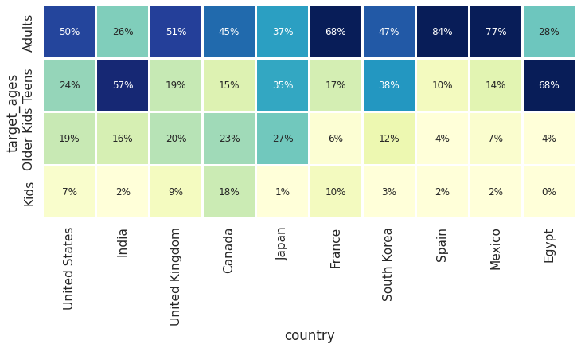
Country
US and UK are closely aligned with their Netflix target ages, but radically different from, example, India or Japan!
Also, Mexico and Spain have similar content on Netflix for different age groups.

Slide 7
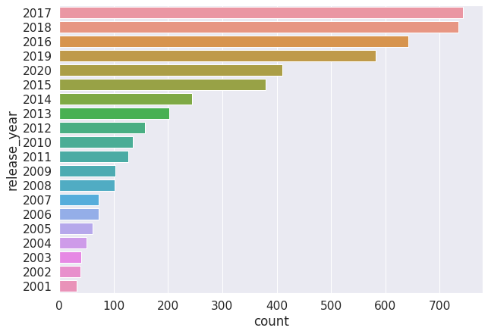
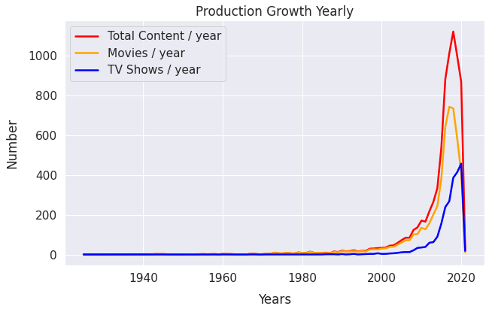
Production Growth
B
Hi
Highest no of movies released in 2017 & 2018

Slide 8
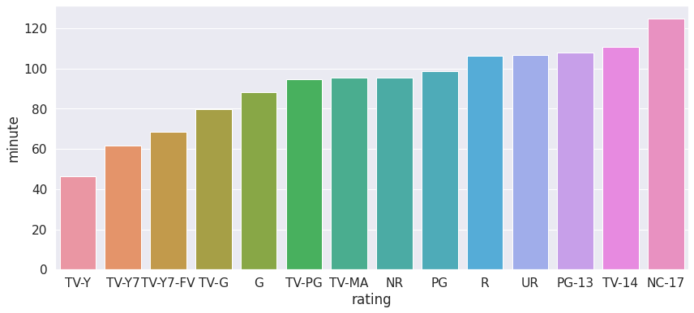
Highest no Rating of single season
Those movies that have a rating of Nc-17 means adults, they have the longest average duration
when it comes to that movies having a TV- Y means kids , they have shortest runtime

Slide 9
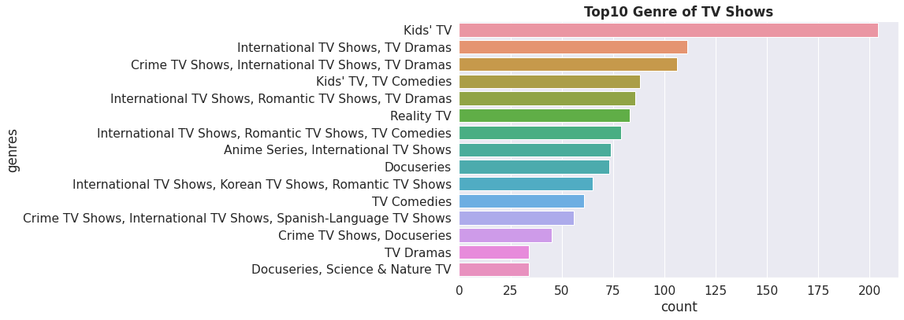
Top 10 Genre of TV Show
K kids Tv is the top most Tv show Genre in Netflix

Slide 10
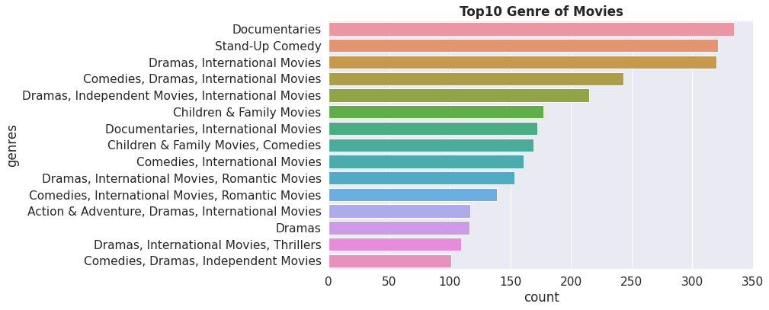
Top 10 Genre in Movies
Documents are the top most genre in Netflix which is followed by stand up comedy
and drama and international movies

Slide 11
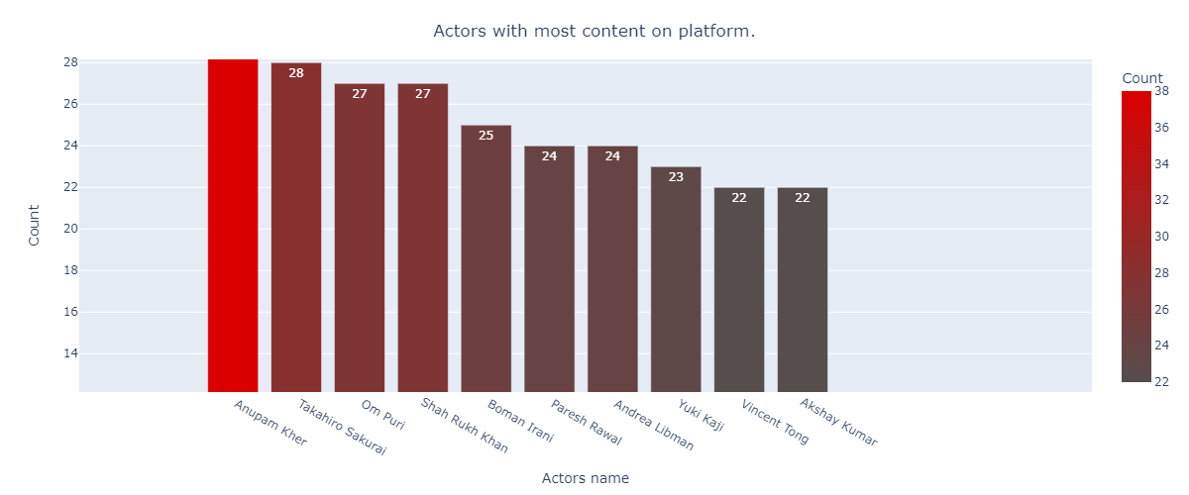
Top 10 Actors
Th
There are 6 of actor in the top 10 of list of number TV shows and movies are from India .
N

Slide 12
Machine learning
Machine learning is a type of artificial intelligent that allow software application to become more accurate at predicting outcome without being explicitly programmed to do so machine learning algorithms use historical data as input to predict new output value
Machine learning are a common use case for machine learning other popular uses include fraud detection, business process automation (BPA) and predictive maintenance

Slide 13
Why machine learning is important
Machine learning is important because it gives enterprises a view of trends in customers behavior and business operational patterns , as well as supports the development of new products. Many of today leading companies such as Facebook, Google and Uber, make machine learning a central part of their operation. Machine learning has become a significant competitive differentiator for many companies

Slide 14
Different types of machine learning
Supervised learning : In this types of machine learning, data scientists supply algorithms with labeled training data and defined the variables they wants the algorithms to assess for correlation.
Unsupervised learning : This types of machine learning involves algorithms that train on unlabeled data.
Reinforcement learning: It is multi step process for which there are clearly defined rules Data scientist program algorithm complete a task

Slide 15
CLUSTERING
Clustering is a type of unsupervised learning method of machine learning .in the unsupervised learning method . The inferences are drawn from the datasets which not contain labelled output variable. It is an exploratory data analysis technique that allow us to analyze he multivariate data sets.
clustering is a task of dividing the data sets into a certain number of cluster in such a manner that the data points belonging to a cluster have similar characteristics clusters are nothing but the grouping of data points such that the distance between the data point s within the clusters is minimal clustering is done to segregate groups with similar traits.

Slide 16
K Mean Clustering.
K-means clustering is an unsupervised learning algorithm. There is no
labeled data for this clustering, unlike in supervised learning . K-means
performs the division of objects into clusters that share similarities an
are dissimilar to the object belonging to another cluster
Advantage & disadvantage:
If the variable are huge , then k means most of the times computationally
faster than hierarchical clustering, and on other hand difficult to predict
k- value .
K –means produce tighter cluster than hierarchical clustering and other
side global cluster , it did not work well .

Slide 17
Dendrogram
Dendrogram is a diagram that allow that shows the hierarchical
relationship between objects . It is most commonly created as an output
from hierarchical clustering .The main use of a Dendrogram Is to work
out the best way to allocate objects to clusters . The dendrogram below
shows the hierarchical clustering of six observation shows on the scatter
plot to the left. It is very important algorithm which are very useful . It is
data structure used with hierarchical clustering algorithms that group
clusters at different heights of a tree where the heights correspond to
distance measure between clusters.

Slide 18
Agglomerative Clustering
The agglomerative clustering is the most well known kind of variable
leveled clustering used to gather in bunches based on their comparability
,its otherwise called agglomerative clustering.
Advantage & disadvantage:
No need any information about how many number of clusters are
required And easy to used on other side we can not take a step back in this
algorithm and Time complexity is higher at least 0(n^2logn)
It can produce an ordering of objects, which may be informative for the display.
The time and space complexity of agglomerative clustering are more than K-means clustering, and in some cases, it is prohibitive.

Slide 19
Challenges
Understand the column of the dataset.
Analyze and visualization of the Netflix Tv shows & movies according to feature.
Find the right chart to show the chart.
Difficulties to find out the correct model.

Slide 20
Conclusion
From elbow and silhouette score, optimal of 26 cluster formed, k means is the best for identification than hierarchical as the evaluation metrics also indicates the same .
Netflix has 5372 movies and 2398 TV shows , there are more number movies on Netflix than TV shows.
TV_MA has the highest no of rating for TV shows I.e. adult rating
Highest number of movies released in 2017 and 2018.
Most content is added to Netflix from October to January
Kids TV is the top most TV show genre in Netflix
Most of the movies have duration of between 50 to 150.

Slide 21
Q/A

